Slide 1



a Linked Dataset with Content-based Analysis of Wikimedia Images
Sebastián Ferrada, Benjamin Bustos and Aidan Hogan
Center for Semantic Web Research
Universidad de Chile

Slide 2
1.
The Goal

Slide 3
Ever wanted to ask a semantic, complicated query on the Web and retrieve related images?
Or had a picture of a place and wonder if there are any similar looking locations elsewhere?

Slide 4
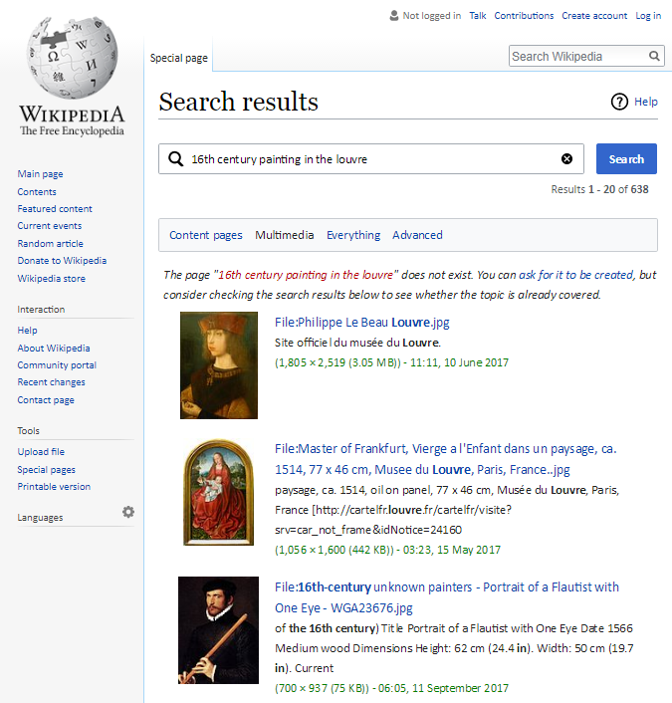
Are there paintings of the 16th century on display in the Louvre?

Slide 5
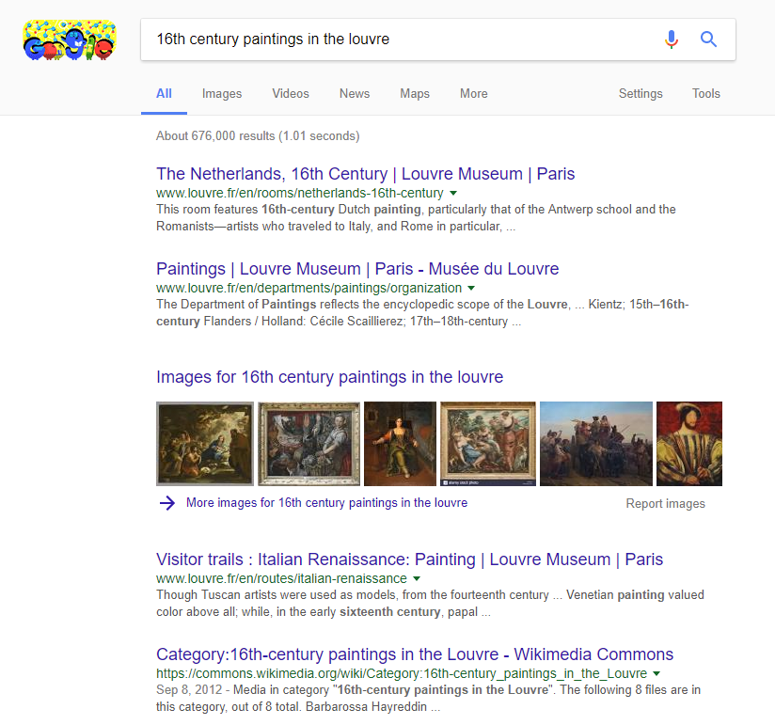
Are there paintings of the 16th century on display in the Louvre?

Slide 6
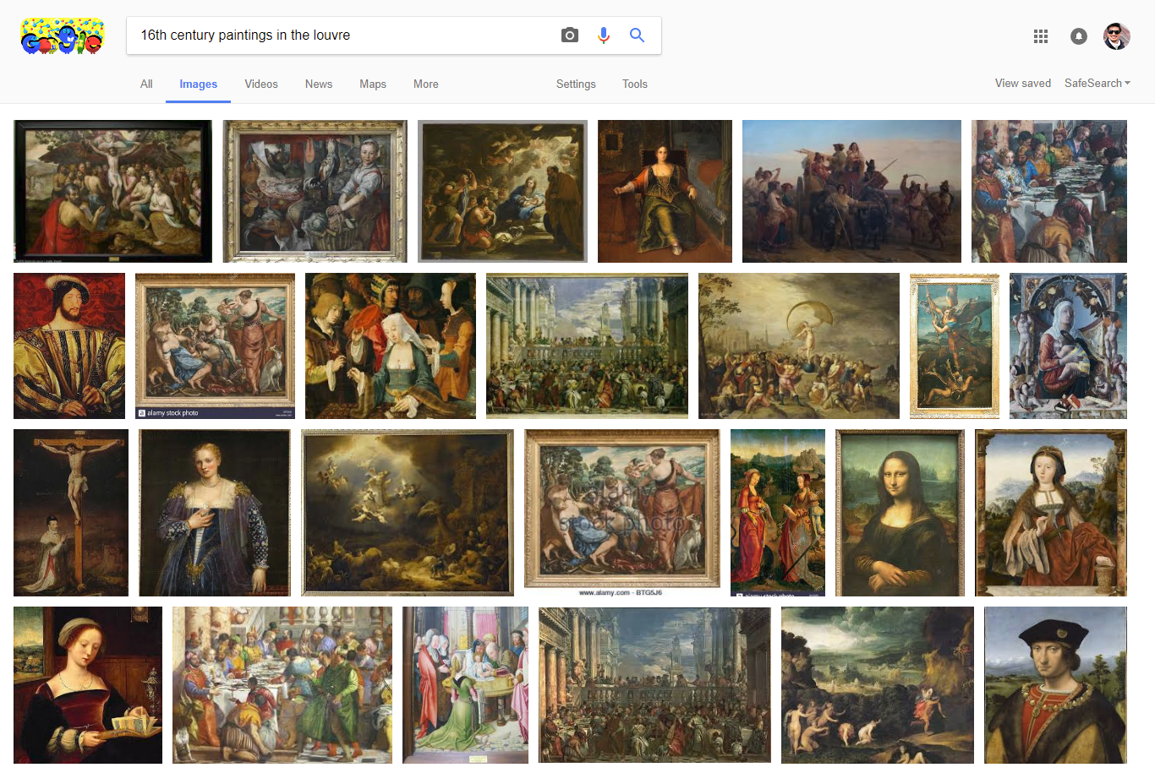
Are there paintings of the 16th century on display in the Louvre?

Slide 7
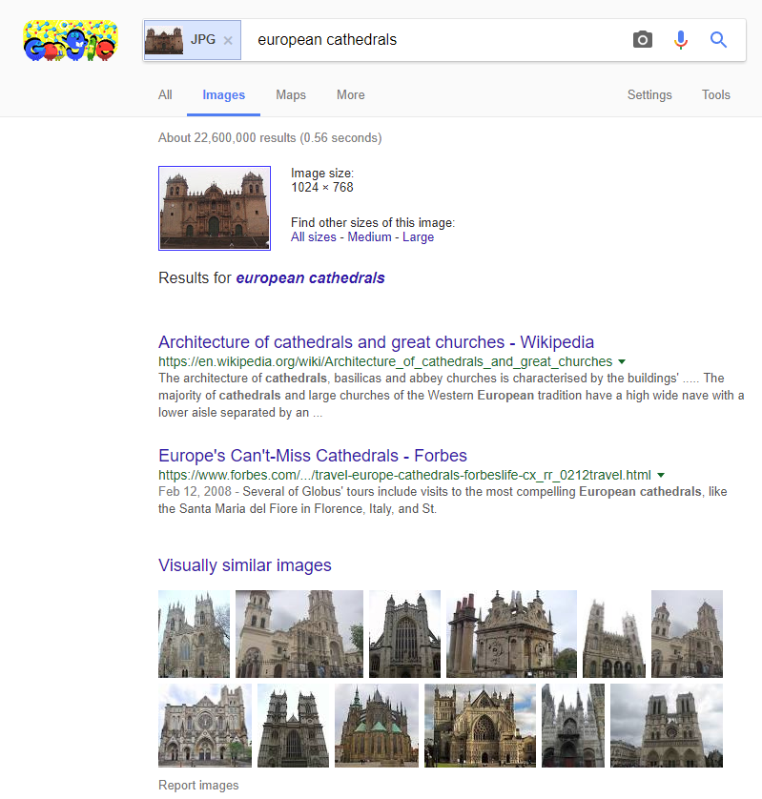
Are there European locations similar to the Cusco Cathedral?

Slide 8
2.
The Background

Slide 9
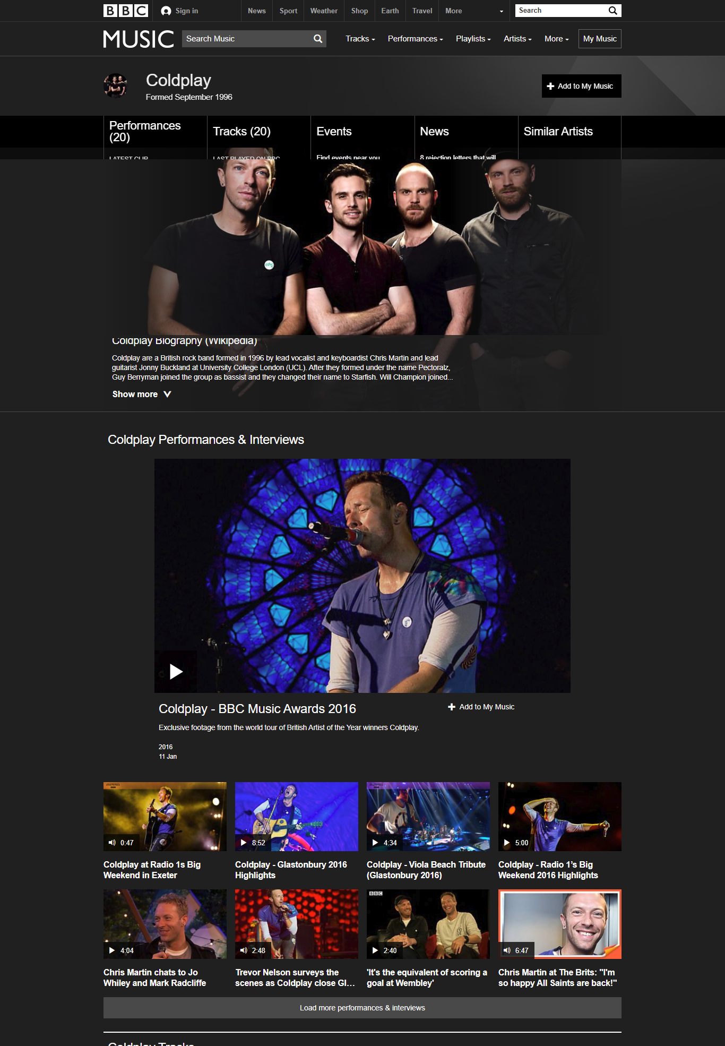
There are many linked datasets for multimedia

Slide 10
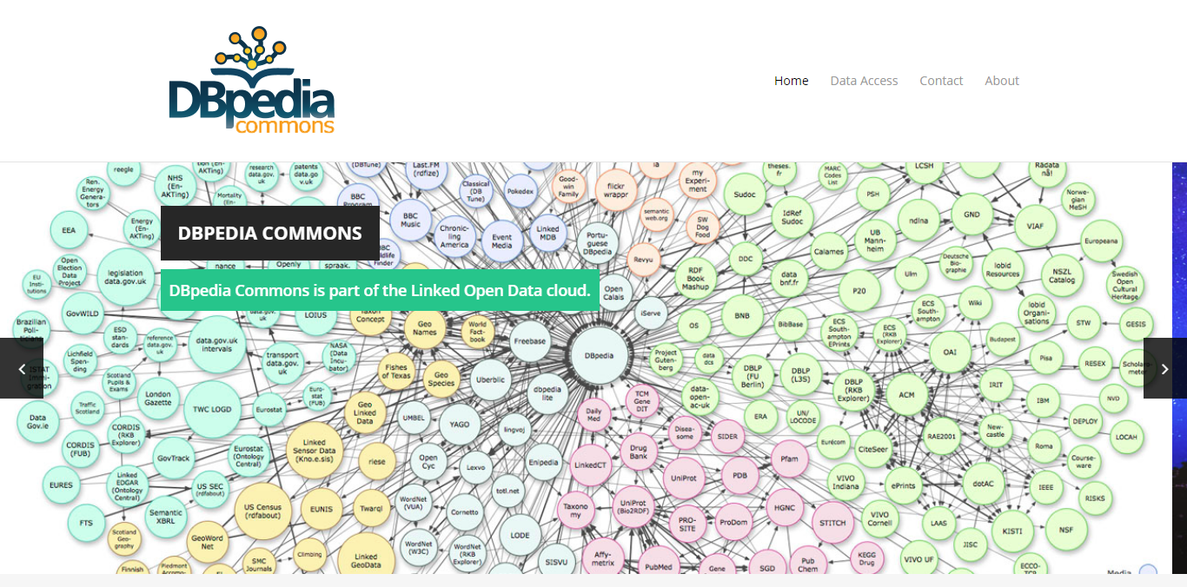
There are many linked datasets for multimedia

Slide 11
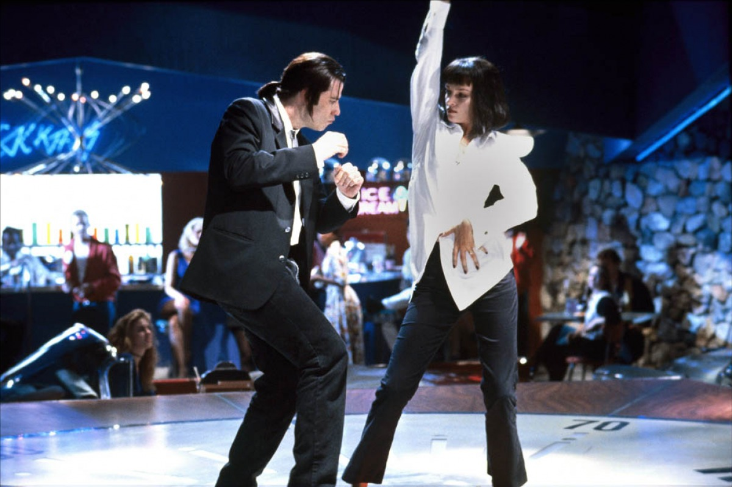
Focus on meta-data and manual annotations
height

Slide 12
3.
The Image Analysis

Slide 13
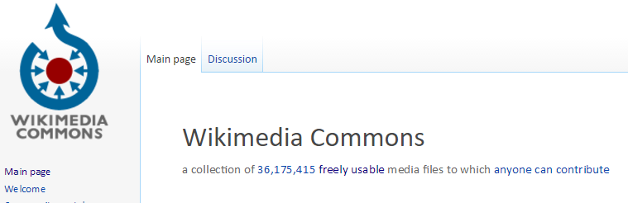
Download Wikimedia Commons Images
14.7 million images (JPG and PNG)
22 TB

Slide 14
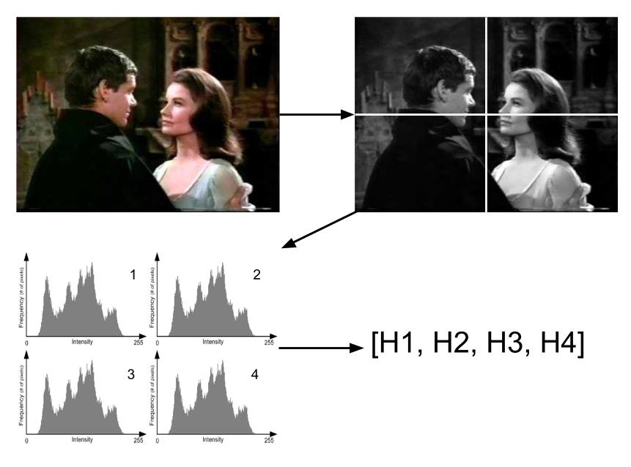
Reference Implementations of Visual Descriptors
Gray Histogram Descriptor (GHD)

Slide 15
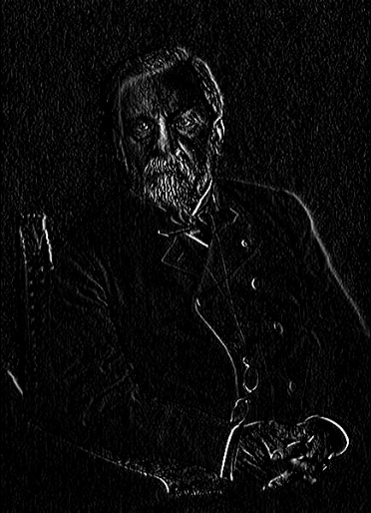
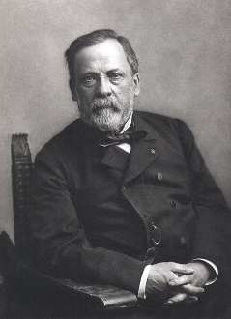
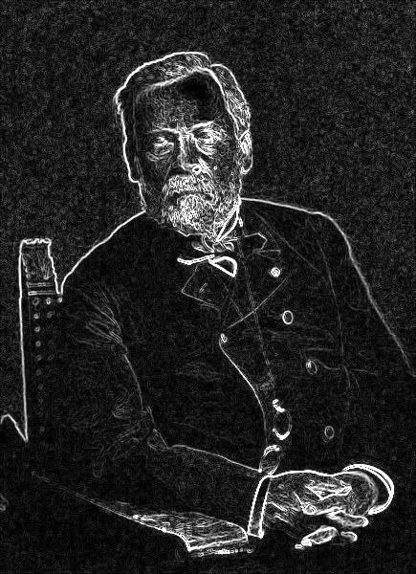
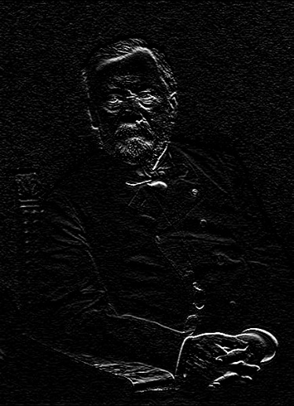
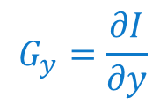
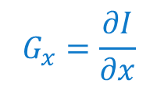

Reference Implementations of Visual Descriptors
Histogram of Oriented Gradients (HOG)
$$G_{x}=\frac{∂I}{∂x}$$
$$\left\|\overset{⃑}{∇}I\right\|$$
$$G_{y}=\frac{∂I}{∂y}$$

Slide 16
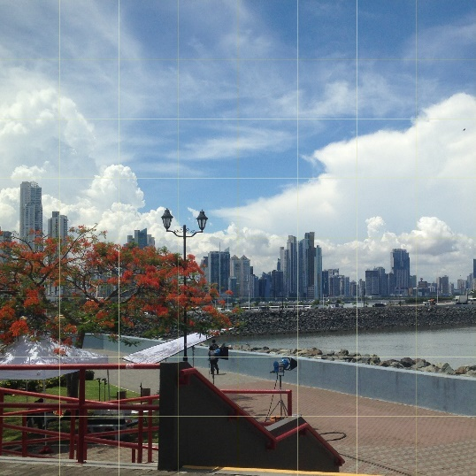

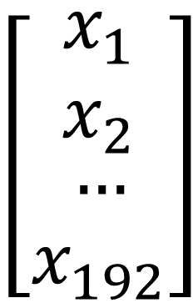
Reference Implementations of Visual Descriptors
Color Layout Descriptor (CLD)
$$\left[\begin{matrix}\begin{aligned}x_{1} \\ x_{2}\end{aligned} \\ … \\ x_{192}\end{matrix}\right]$$
YUV
DCT

Slide 17
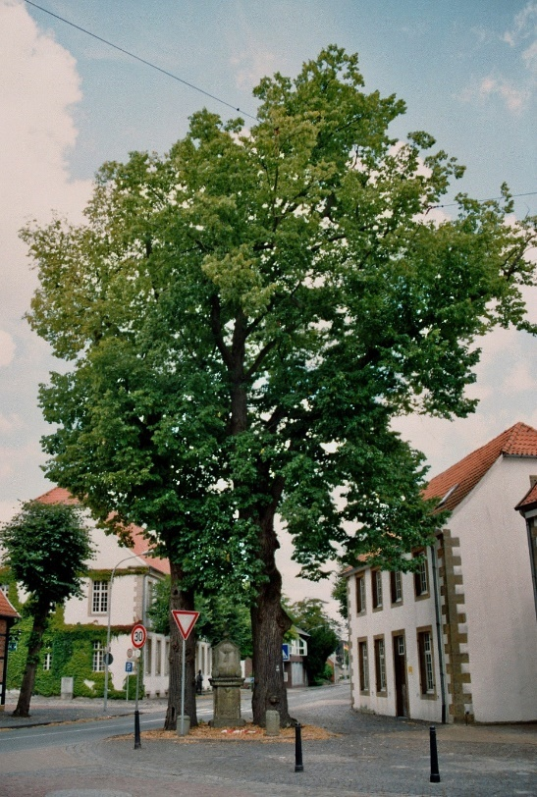
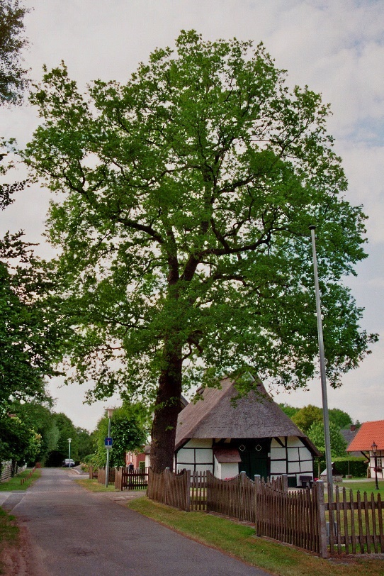
Compute Static Similarity Relations
similar
descriptorType
distance

Slide 18
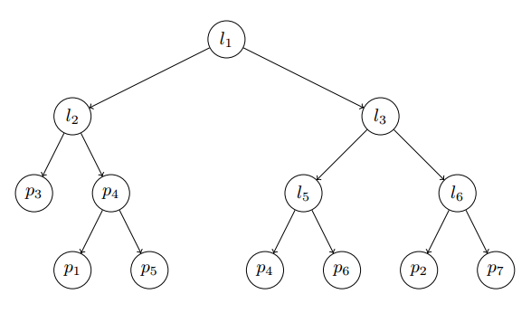
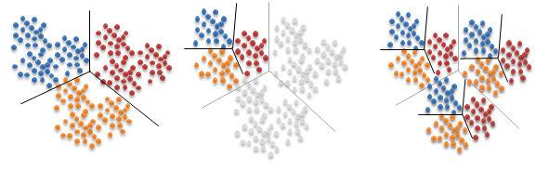
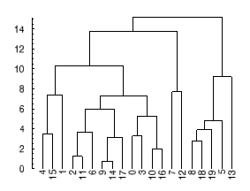
A fast, scalable and accurate tool was needed
Fast Library for Approximate Nearest Neighbors (FLANN)

Slide 19
FLANN
 | Ground Truth | FLANN
Execution time [mins] | 279 | 17
Precision | 100% | 79%

Slide 20
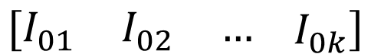
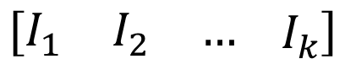
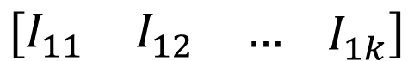
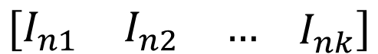
Implementation
Matrix 1
$$\left[\begin{matrix}I_{01} & I_{02} & …\end{matrix} I_{0k}\right]$$
Matrix 2
$$\left[\begin{matrix}I_{11} & I_{12} & …\end{matrix} I_{1k}\right]$$
Query Matrix
$$\left[\begin{matrix}I_{1} & I_{2} & …\end{matrix} I_{k}\right]$$
…
…
Matrix n
$$\left[\begin{matrix}I_{n1} & I_{n2} & …\end{matrix} I_{nk}\right]$$

Slide 21
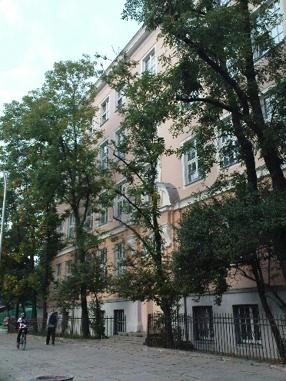
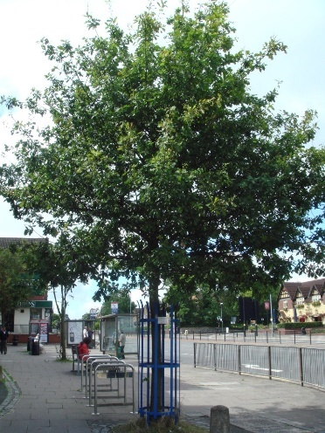
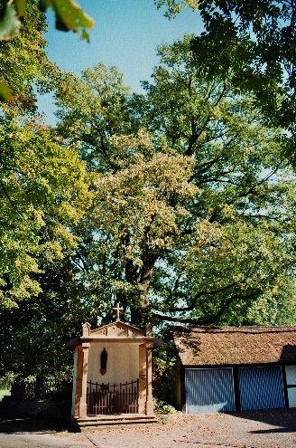
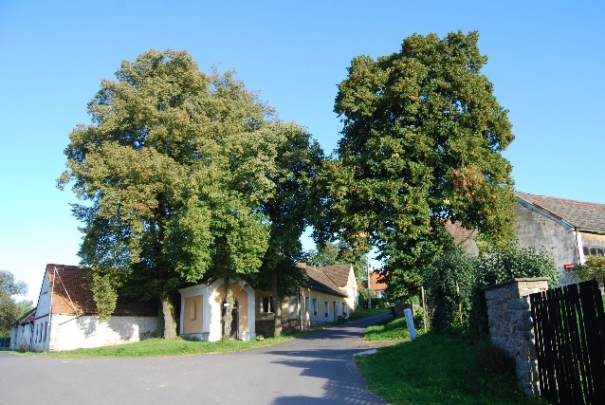
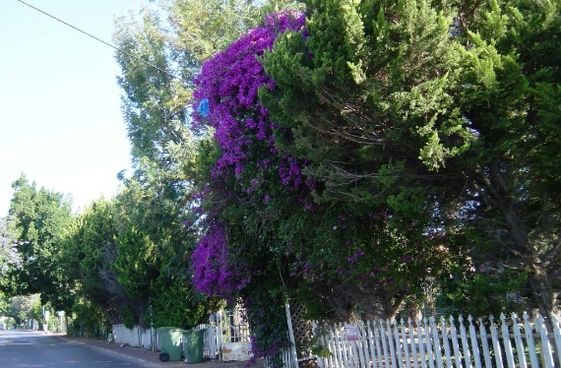
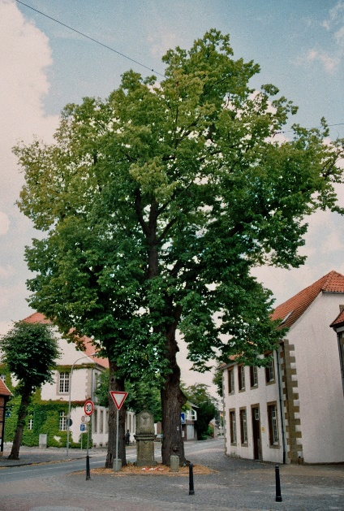
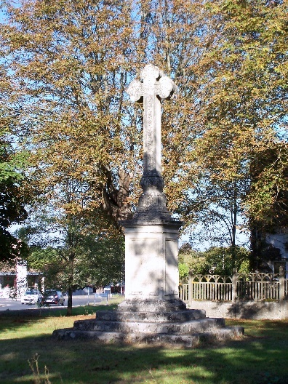

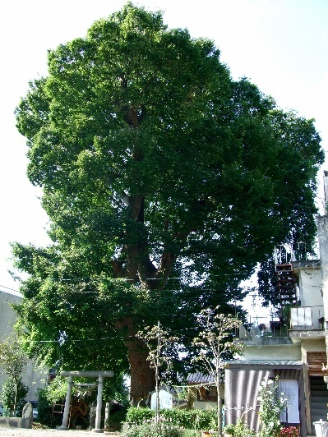
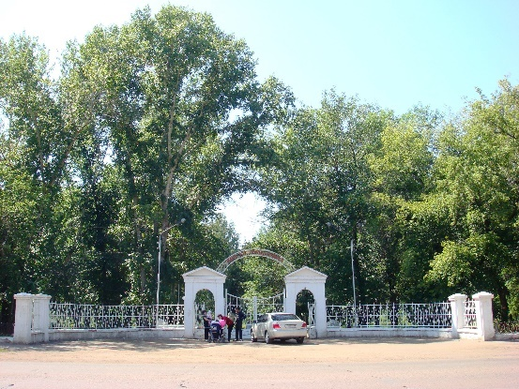
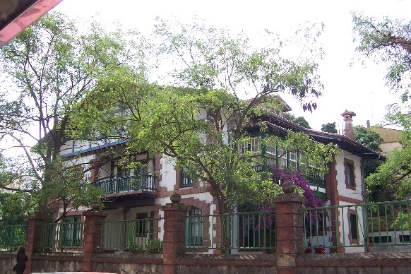
Results (HOG)

Slide 22
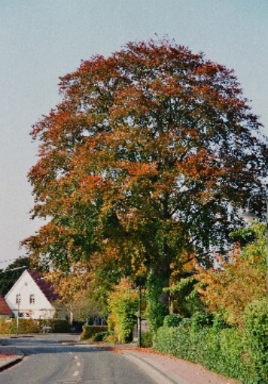
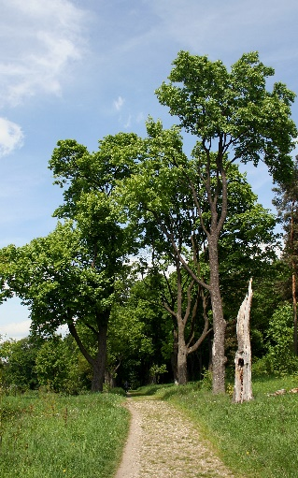
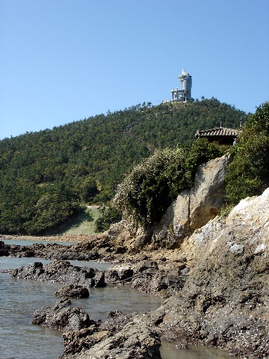
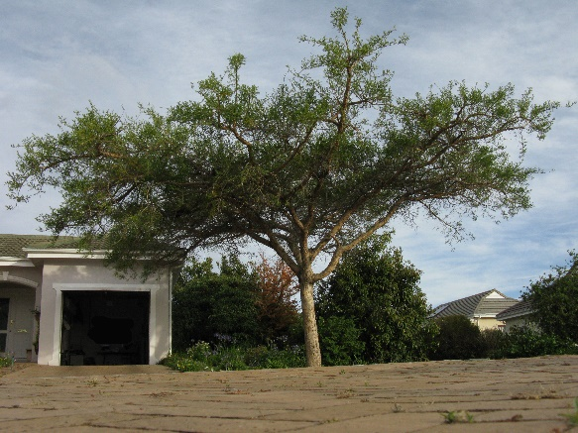
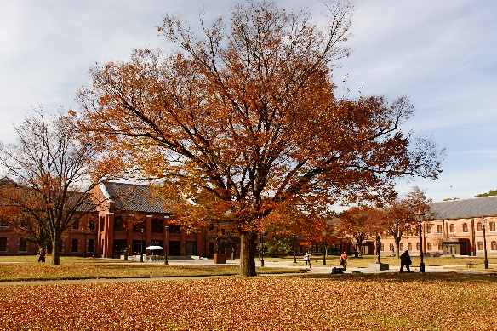
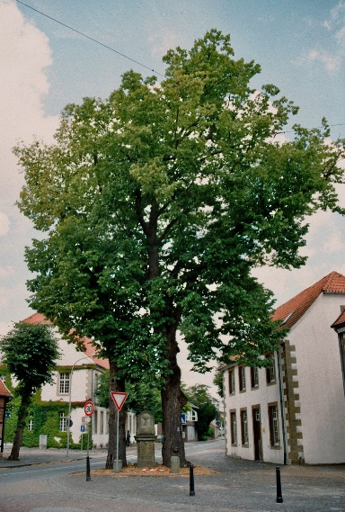
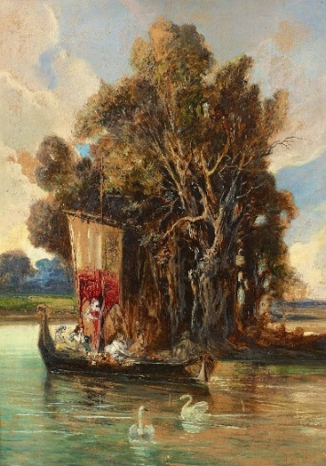
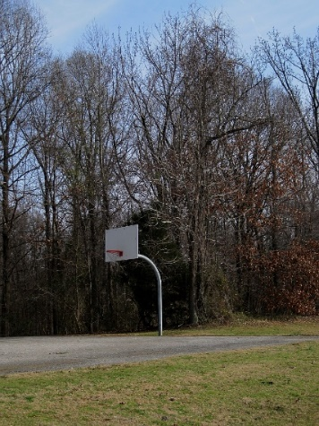
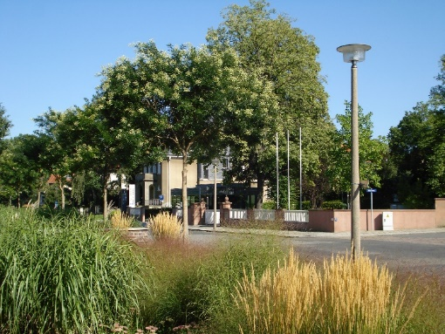
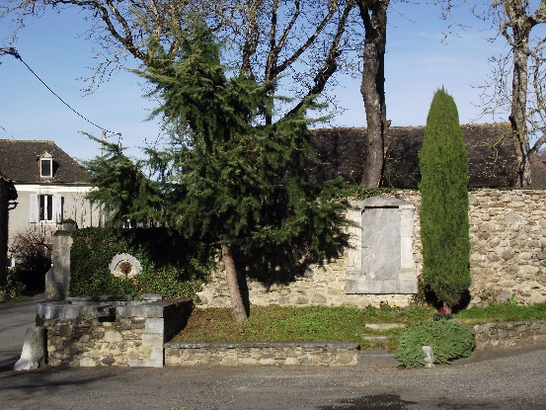
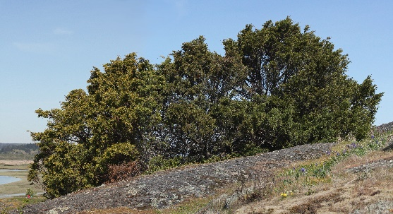
Results (GHD)

Slide 23
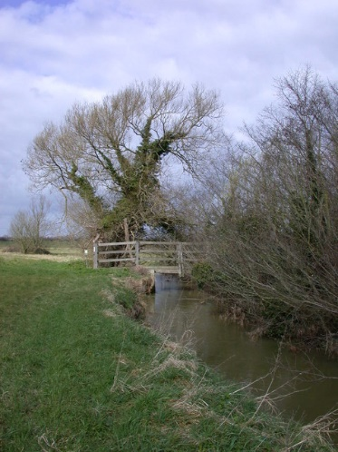
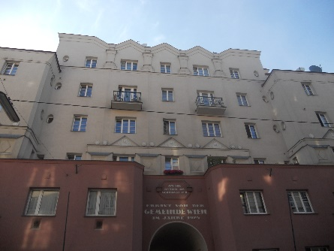
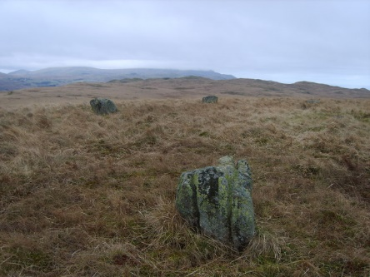








Results (CLD)

Slide 24
Summary
13 Hours
Computation time of k-NN per descriptor
3 Similarity Graphs
Containing similarity relations: 14.7M nodes, 147M edges each
442,959,000 Similarity Links
In total

Slide 25
4.
The Linked Dataset

Slide 26

IMGpedia Ontology

Slide 27

Links to DBpedia

Slide 28


Links to DBpedia
imo:associatedWith
dbr:Quentin_Tarantino

Slide 29
14,765,300 Images
Visual Entities
44,295,900 Descriptors
3 descriptors per image
442,959,000 Similarity Links
Image Relations
12,683,424 Context Links
To DBpedia

Slide 30
3,119,207,705
RDF Triples in IMGpedia

Slide 31

IMGpedia is accesible as…

Slide 32

SPARQL Endpoint
imgpedia.dcc.uchile.cl/sparql
Notes:
Virtuoso server, provides endpoint anr URL rewrite tools for dereferencing IRIS

Slide 33

RDF Dumps

Slide 34
5.
The Results

Slide 35










Use-cases – Similarity Queries
SELECT DISTINCT ?Target ?Distance
WHERE {
?rel imo:sourceImage im:Hopsten_Marktplatz_3.jpg ;
imo:usesDescriptorType imo:GHD ;
imo:targetImage ?Target ;
imo:distance ?Distance .
}
ORDER BY ?Distance
11
11,2
11,6
11,9
11,9
11,9
12
12,1
12,1
12,2
Notes:
Obtaining a specific descriptor, sorted by distance

Slide 36
Use-cases – Semantic Image Retrieval
SELECT DISTINCT ?url ?label
WHERE {
SERVICE <https://dbpedia.org/sparql> {
?res a yago:Wikicat16th-centuryPaintings ;
dcterms:subject dbc:Paintings_of_the_Louvre ;
rdfs:label ?label
FILTER(LANG(?label)="en") }
?img imo:appearsIn ?res ;
imo:fileURL ?url .
}

Slide 37

Use-cases – Semantic Image Retrieval

Slide 38
Use-cases – Visuo-semantic queries
SELECT DISTINCT ?source ?target
WHERE {
SERVICE <https://dbpedia.org/sparql> {
?sres dcterms:subject dbc:Roman_Catholic_cathedrals_in_Europe }
?source imo:appearsIn ?sres ;
imo:similar ?target .
?target imo:appearsIn ?tres .
SERVICE <https://dbpedia.org/sparql> {
?tres dcterms:subject ?subject .
FILTER(CONTAINS(STR(?sub), “Museum”))}
}

Slide 39

Use-cases – Visuo-semantic queries

Slide 40
Improve Results Using Property Paths
SERVICE <https://dbpedia.org/sparql> {
?sres dcterms:subject/skos:broader* dbc:Roman_Catholic_cathedrals_in_Europe
} ...

Slide 41

Improve Results Using Property Paths

Slide 42
6.
The Conclusions

Slide 43
Conclusions
IMGpedia is a linked dataset that provides feature descriptors of images along with similarity relations among them

Slide 44
Conclusions
IMGpedia enables combining visual similarity queries with semantic queries
Notes:
Providing semantic image retrieval and visuosemantic queries

Slide 45
Conclusions
imo:associatedWith relation enables to combine information of IMGpedia with DBpedia facts, which can enrich the results

Slide 46
Conclusions
The underlying methodology can be reused. Code is freely available.

Slide 47
7.
The Future

Slide 48

Develop a Web Application

Slide 49

Include links to Wikidata Resources

Slide 50



Incorporate more descriptors
Train our own network?

Slide 51


Explore other algorithms and indexing techniques

Slide 52


Explore new relations among images
contains
sameObject

Slide 53
Thanks!
Any questions?
You can find me at:
sferrada@dcc.uchile.cl
@ferradest on Twitter

Slide 54
a Linked Dataset with Content-based Analysis of Wikimedia Images
Sebastián Ferrada, Benjamin Bustos and Aidan Hogan
Center for Semantic Web Research
Universidad de Chile

